Slide 1

Authentication and Authorization in ASP.NET Core
Email: letienthanh0212@gmail.com
Skype: lethanh212
Medium: https://medium.com/@letienthanh0212

Slide 2
Prerequesites
Beginning level of ASP.NET Core
Understand about Entity Framework

Slide 3
Agenda
Introduction about Authentication and Authorization
Authentication with/without Identity Framework
Centralize Authentication of using Identity Provider
Apply Authorization

Slide 4

Authentication

Slide 5
Authentication in ASP .NET Core
Cookie Authentication
Identity Framework
Identity Provider

Slide 6
Authorization
X

Slide 7
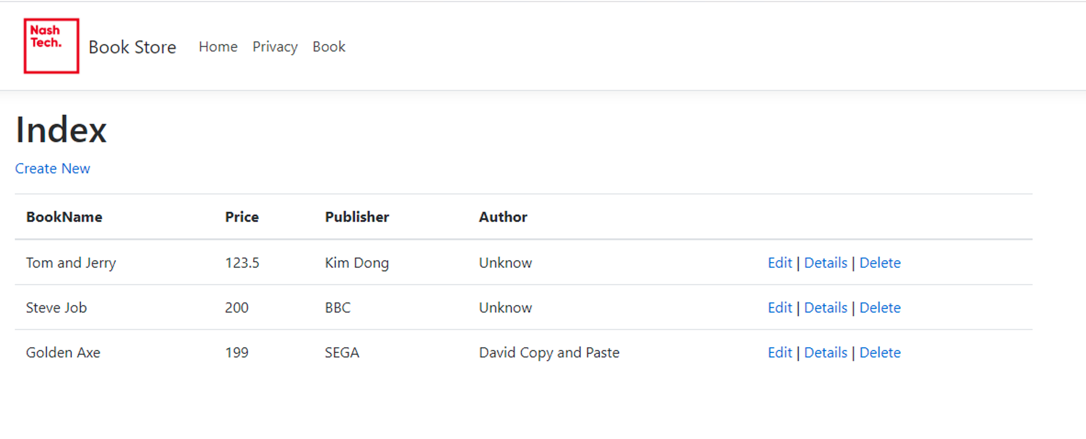
Setting up
Create sample application – Book Store.
Use Entity Framework.

Slide 8
Authentication schemes

Slide 9
Claims-based Identity
Name
ClaimsIdentity
DOB
ClaimsPrincipal
ClaimsIdentity
Nationality

Slide 10



Identity Cookie

Slide 11
Identity Cookie
Tracks to which user a request belongs to
Safely stores user information
Symmetric encryption, key only on server
Used to re-construct the ClaimsPrincipal object on each request
Secured by ASP.NET Core Data Protection

Slide 12
External Identity Providers
Google
Facebook
Microsoft
Twitter

Slide 13

External Identity Providers

Slide 14
External Identity Providers
https://developers.google.com/identity/sign-in/web/sign-in
https://console.developers.google.com/

Slide 15
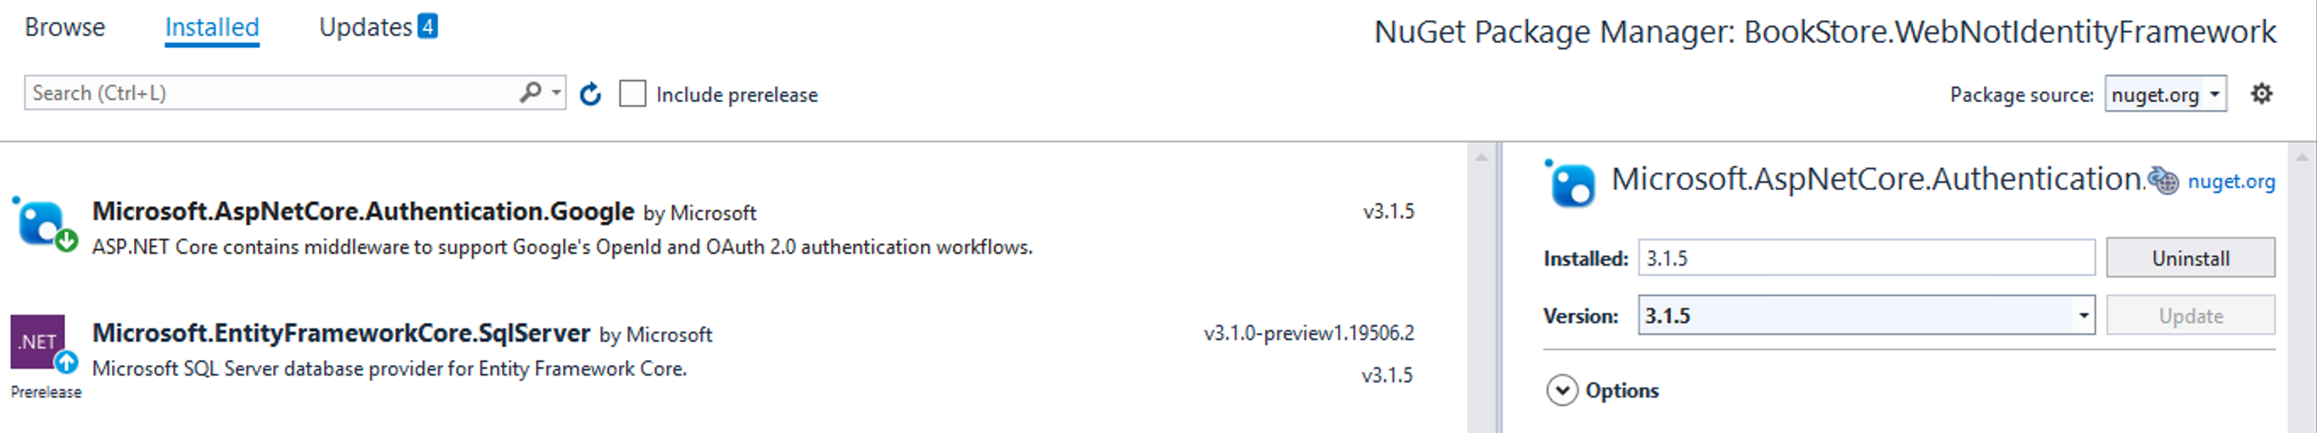
Apply Google Authentication
dotnet add package Microsoft.AspNetCore.Authentication.Google

Slide 16
Scheme Actions
Authenticate
Challenge
Forbid

Slide 17
Part 1 - Summary
Authentication and Authorization
Claim, Claim Identity, Claim Principal
Cookie
Scheme actions
External Authentication

Slide 18
What is Identity Framework?
Framework around Cookie Authentication
Includes helper classes and UI
Customizable
Configurable
External Authentication

Slide 19
Identity Framework Features
Login and Logout
User registration
Third-parties login
Password management (change/forget password)
Account lockout
2 factor authentication

Slide 20
Role and Role Claims
User
UserName
Address
CompanyStartedDate
RoleClaims
Permission 1
Permission 2
Permission 3
Permission 4
……..
UserClaims
DateOfBirth
BankAccount
Role
Administrator
Viewer

Slide 21
Role and Role Claims
Claims
UserName=”thanhtest@domain.com”
Address=”HaNoi”
CompanyStartedDate=
“02/12/2008”
DateOfBirth=“01/10/1980”
BankAccount=“xxx”
Role=“Administrator”
Permission=“AddBook”
Permission=“ViewBook”

Slide 22
Email functionality
Email Functionality
Register User
Forget Password

Slide 23

Confirm account without sending email

Slide 24
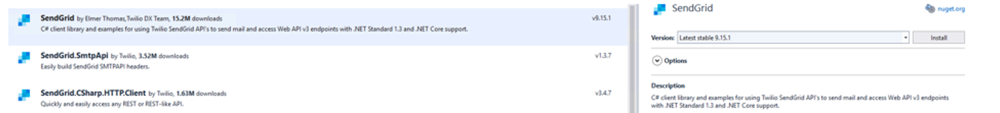
SendGrid Library

Slide 25

An application landscape
Web API 1
Web API 2
Web API 3
Web App 1
Browser

Slide 26

A typical modern application
Web API 1
Web API 2
Web API 3
Web App
Mobile Application
Browser

Slide 27


An Identity Provider
Web API 1
Web API 2
Web API 3
Web App
Mobile Application
Identity Provider
Browser

Slide 28
New BookStore Architecture
ASP.NET Core Web API
ASP.NET Core Web App
Identity Provider

Slide 29




The process of Authentication

Slide 30




Concept of token
Token
Clients
Identity Provider
Claims + Resources
Users

Slide 31

Tokens
Identity Token
Access Token
Clients
Identity Provider

Slide 32
Standards
Access Token
= OAuth2 (delegated authorization)
Access Token
Identity Token
= OpenIDConnect (OIDC) (federated authentication)

Slide 33


Client ID + (Secret)
Scopes
Response Type
Redirect URI
Authorization
endpoint
Client
Identity Provider
Artifacts requested in Response Type
delivered to redirect URI
Browser

Slide 34
Front Channel
Interaction with Authorization endpoint via browser
Should use Form Post instead of Query string
Front-channel is unsecure

Slide 35
Authorization Code Flow
Access Token
Identity Token
Code is sent from Client to Token endpoint
(ClientID +ClientSecret)
Client
Identity Provider
Code is sent from Authorization endpoint
Browser

Slide 36
PKCE
Generate a secret
Access Token
Identity Token
Code is sent from Client to Token endpoint
(ClientID +ClientSecret)
Client
Identity Provider
Code is sent from Authorization endpoint
Browser

Slide 37
Other flows
Implicit and Hybrid
Client credentials

Slide 38
Client Credentials flow
Access Token
Client Credentials are sent from Client to Token endpoint
Client
Identity Provider

Slide 39
Which Flow?
Interactive client?
Code flow + PKCE
Yes
No
Client Credentials Flow

Slide 40


Single Sign On (SSO)
Access Token
Identity Token
Client 1
Identity Provider
Client 2
Browser

Slide 41
Client Credentials flow

Slide 42
Verify Token
Does the token really come from trusted authority?
Is the Token’s content not changed?

Slide 43
How does the client/api verify token?
Identity Provider creates hash of token’s content
Hash is encypted using Private Key
Encrypted value is included in Token that return to Client/API (Signature)
Client/API uses public key to decypt
Client/API hash readable content in Token
Compare (5) with (4)

Slide 44

Self-contained Access Token
Access Token

Slide 45
Refresh Token
Separate Token with Access Token
Used to get new Access Token
User don’t need to re-authenticate
Longer expiration time than access token

Slide 46

Refresh Token
Access Token
Identity Token
Client
Refresh Token
Identity Provider

Slide 47
Reference Token
Alternative for Refresh Token
An Access Token that doesn’t include claim
Reference Token contain Unique ID

Slide 48

Refresh Token
Introspection
endpoint
API
Identity Provider

Slide 49
Authorization

Slide 50
THANK YOU!
Source Code: https://github.com/thanhle0212/IdentityProviderSample
Email: letienthanh0212@gmail.com
Skype: lethanh212
Medium: https://medium.com/@letienthanh0212

